Slide 1
NARULA
INSTITUTE
OF
TECHNOLOGY
Notes:
1

Slide 2
THE
THEVENIN’S
THEOREM
Notes:
2

Slide 3
Presenters
COMPUTER SCIENCE ENGINEERING
1st year
SAMIR IMTIAZ
ROHAN PAUL CHOUDHURY
PRATYUSH GAUTAM
SARTHAK DAS
SANCHAYAN MALLICK

Slide 4

ACKNOWLEDGMENT
When performing network analysis, Thevenin's theorem is a very helpful tool. It allows for a non-varying portion of a circuit to be replaced with a simplified design, thus simplifying the analysis of the entire network. This equivalent circuit performs the same way as the original circuit would.
Thevenin's theorem states that any linear, two-terminal portion of a network can be replaced by a Thevenin equivalent circuit. A Thevenin equivalent circuit consists of a voltage source (V_{Th}) in series with a resistor (R_{Th}) where V_{Th} is the open-circuit voltage at terminals A-B and R_{Th} is the equivalent resistance at terminals A-B. This equivalent circuit can be seen in Figure 1 below. It is important to replace independent sources with their internal resistances when solving for R_{Th}, i.e. current sources are replaced with open circuits and voltage sources are replaced with short circuits.
4

Slide 5

CONTENT
 | TOPIC
1. | Thevenin’s Theorem
2. | Thevenin’s equivalent circuit
3. | Find the Equivalent Resistance (Rs)
4. | Find the Equivalent Voltage (Vs)
5. | Thevenin’s Theorem
6. | Thevenin’s Theorem Summary
5

Slide 6
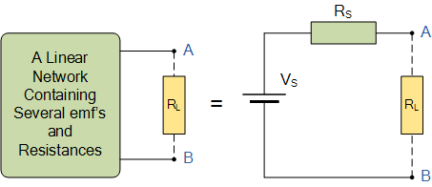
THEVENIN’S THEOREM
Thevenin theorem is an analytical method used to change a complex circuit into a simple equivalent circuit consisting of a single resistance in series with a source voltage.
Thevenin’s Theorem states that “Any linear circuit containing several voltages and resistances can be replaced by just one single voltage in series with a single resistance connected across the load“. In other words, it is possible to simplify any electrical circuit, no matter how complex, to an equivalent two-terminal circuit with just a single constant voltage source in series with a resistance (or impedance) connected to a load as shown below.
Thevenin’s Theorem is especially useful in the circuit analysis of power or battery systems and other interconnected resistive circuits where it will have an effect on the adjoining part of the circuit.
6

Slide 7
Thevenin’s equivalent circuit
As far as the load resistor R_{L} is concerned, any complex “one-port” network consisting of multiple resistive circuit elements and energy sources can be replaced by one single equivalent resistance Rs and one single equivalent voltage Vs. Rs is the source resistance value looking back into the circuit and Vs is the open circuit voltage at the terminals.
7

Slide 8
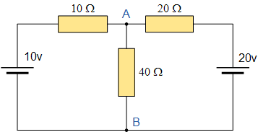
For example, consider the circuit from the previous section.
Firstly, to analyses the circuit we have to remove the center 40Ω load resistor connected across the terminals A-B, and remove any internal resistance associated with the voltage source(s). This is done by shorting out all the voltage sources connected to the circuit, that is v = 0, or open circuit any connected current sources making i = 0. The reason for this is that we want to have an ideal voltage source or an ideal current source for the circuit analysis.
The value of the equivalent resistance, Rs is found by calculating the total resistance looking back from the terminals A and B with all the voltage sources shorted. We then get the following circuit.
8

Slide 9
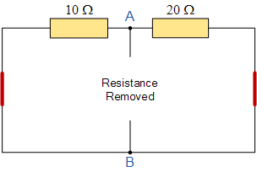

Find the Equivalent Resistance (Rs)
The voltage Vs is defined as the total voltage across the terminals A and B when there is an open circuit between them. That is without the load resistor R_{L} connected.
9

Slide 10
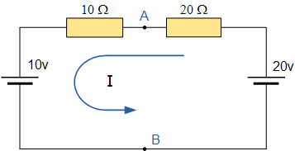

Find the Equivalent Voltage (Vs)
We now need to reconnect the two voltages back into the circuit, and as V_{S} = V_{AB} the current flowing around the loop is calculated as:
This current of 0.33 amperes (330mA) is common to both resistors so the voltage drop across the 20Ω resistor or the 10Ω resistor can be calculated as:
V_{AB} = 20 – (20Ω x 0.33amps) = 13.33 volts.
10

Slide 11
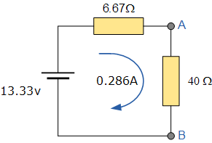

or
V_{AB} = 10 + (10Ω x 0.33amps) = 13.33 volts, the same.
Then the Thevenin’s Equivalent circuit would consist or a series resistance of 6.67Ω and a voltage source of 13.33v. With the 40Ω resistor connected back into the circuit we get:
and from this the current flowing around the circuit is given as:
which again, is the same value of 0.286 amps, we found using Kirchhoff’s circuit law in the previous circuit analysis tutorial.
11

Slide 12

ADVANTAGES OF THEVENIN’S THEOREM
IT IS USEFUL TO ANALISE THE LARGE DISTRIBUTED NETWORKS .
IT IS USEFUL TO ANALISE THE PERFORMANCE AT ANY POINT.
THIS THEOREM IS APPLICABLE IN BOTH AC AND DC NETWORKS.

Slide 13
DISADVANTAGES OF THEVENIN’S THEOREM
IT IS ONLY APPLICABLE FOR LINEAR AND BILATERAL NETWORKS.
IT IS NOT APPLICABLE FOR UNILATERAL AND NONLATERAL NETWORKS.
SOMETIMES POWER DISTRIBUTION IS NOT SAME AS REAL CIRCUIT.

Slide 14
Conclusion
can be used as another type of circuit analysis method and is particularly useful in the analysis of complicated circuits consisting of one or more voltage or current source and resistors that are arranged in the usual parallel and series connections.
While Thevenin’s circuit theorem can be described mathematically in terms of current and voltage, it is not as powerful as Mesh Current Analysis or Nodal Voltage Analysis in larger networks because the use of Mesh or Nodal analysis is usually necessary in any Thevenin exercise, so it might as well be used from the start. However, Thevenin’s equivalent circuits of Transistors, Voltage Sources such as batteries etc, are very useful in circuit design.
14

Slide 15
MORE INFO AVAILABLE AT
* ELECTRONIC TUTORIALS
* PHYSICS INDIA
* PREFER SOME BOOKS
* TESLA PHYSICS
* KNOWLEDGE OF INFINITY
BIBLIOGRAPHY
15

Slide 16
Thank You !
Notes:
16

